Slide 1
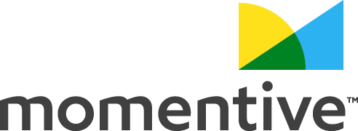
Logo Design Analysis
Puppy Love - Logo Design Analysis - Results
Created: 8. 11. 2021

Slide 2



Logo Design Analysis
Summary
Stimuli
Benchmarks
Responses
2 logos Monadic design: Each respondent saw only 1 stimulus and answered questions about it.
The results of this analysis were compared against SurveyMonkey Benchmarks from 100+ company logos in these industries:
Food
SurveyMonkey Benchmarks are the aggregated results of previous studies conducted through SurveyMonkey, with the same attribute questions.
782 total responses collected from 8. 11. 2021 to 8. 11. 2021

Slide 3


Stimuli
Stimuli we tested
Logo 1
Logo 2

Slide 4
Summary Scorecard - top 2 box
Key metrics for your concepts based on the top 2 box score
Confidence level
95%
A Logo 1
B Logo 2
FoodBenchmark
Overall appeal | 63% B | 47% | 47%
Unique | 34% B | 19% | 31%
Visually appealing | 49% B | 32% | 32%
Stands out | 41% B | 29% | 39%
N = 782
Location: United States (USA); Regions: All regions; Gender Balancing: Custom; Age: 18-99; Age Balancing: None; Income: $0-$200k+;

Slide 5
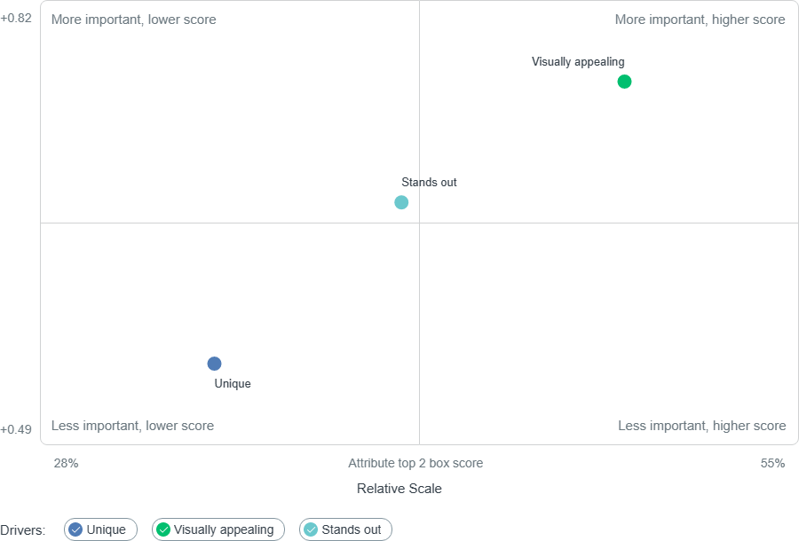
Key drivers to Overall appeal
Correlation to Overall appeal
Logo 1
N = 782
Location: United States (USA); Regions: All regions; Gender Balancing: Custom; Age: 18-99; Age Balancing: None; Income: $0-$200k+;

Slide 6
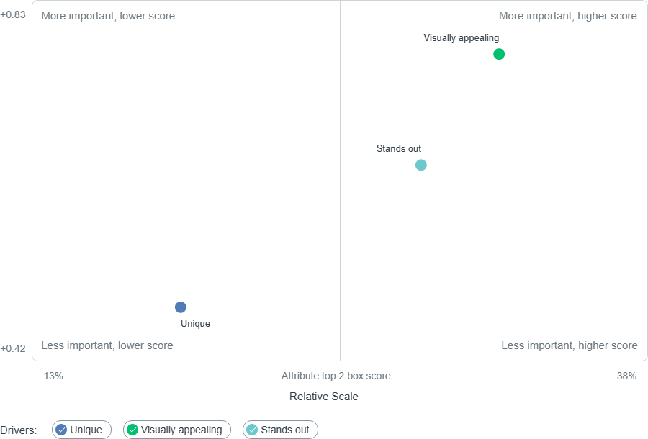
Key drivers to Overall appeal
Correlation to Overall appeal
Logo 2
N = 782
Location: United States (USA); Regions: All regions; Gender Balancing: Custom; Age: 18-99; Age Balancing: None; Income: $0-$200k+;

Slide 7
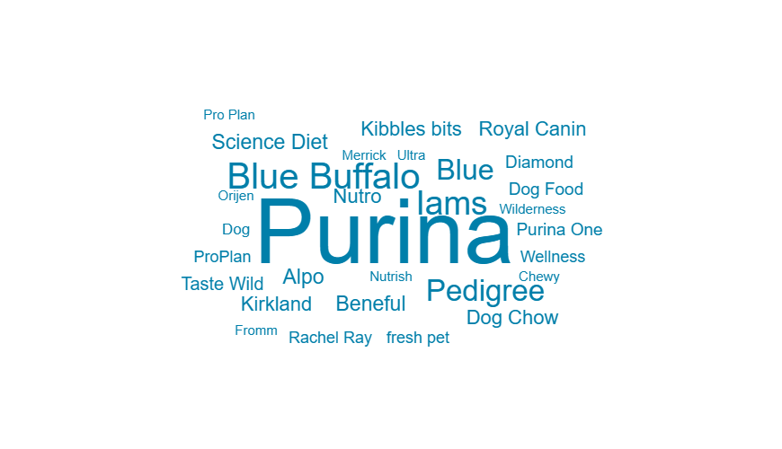
Custom question before stimuli
What is your favorite dog food brand?
Logo 1
Top 10 words
Word Cloud
Purina |  | 17.93% | 71
Blue Buffalo |  | 5.81% | 23
Iams |  | 5.05% | 20
Pedigree |  | 4.29% | 17
Blue |  | 4.04% | 16
Alpo |  | 2.27% | 9
Beneful |  | 2.27% | 9
Science Diet |  | 2.27% | 9
Kirkland |  | 2.02% | 8
Nutro |  | 2.02% | 8
N = 782
Location: United States (USA); Regions: All regions; Gender Balancing: Custom; Age: 18-99; Age Balancing: None; Income: $0-$200k+;

Slide 8
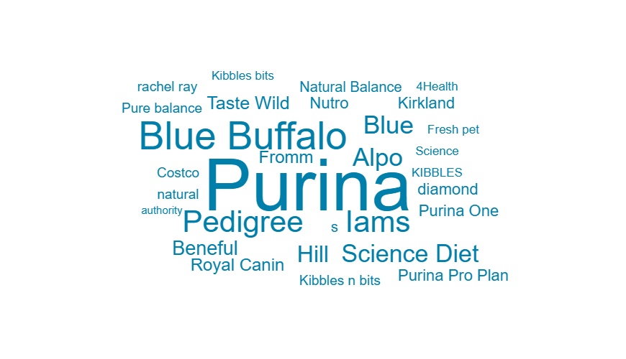
Custom question before stimuli
What is your favorite dog food brand?
Logo 2
Top 10 words
Word Cloud
Purina |  | 13.98% | 53
Blue Buffalo |  | 6.60% | 25
Iams |  | 4.75% | 18
Pedigree |  | 4.75% | 18
Blue |  | 3.69% | 14
Alpo |  | 3.69% | 14
Science Diet |  | 3.43% | 13
Hill |  | 3.17% | 12
Beneful |  | 2.37% | 9
Taste Wild |  | 2.11% | 8
N = 782
Location: United States (USA); Regions: All regions; Gender Balancing: Custom; Age: 18-99; Age Balancing: None; Income: $0-$200k+;

Slide 9
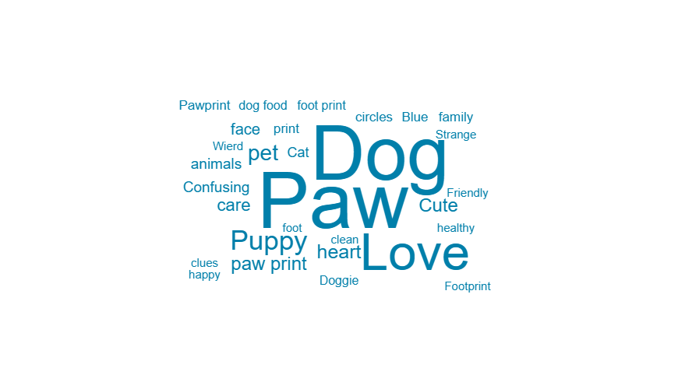
Attribute: First reaction
What's the first word that comes to mind when you look at this logo?
Logo 1
Top 10 words
Word Cloud
Paw |  | 25.81% | 104
Dog |  | 24.81% | 100
Love |  | 15.14% | 61
Puppy |  | 6.20% | 25
pet |  | 4.22% | 17
heart |  | 3.23% | 13
Cute |  | 2.98% | 12
paw print |  | 2.98% | 12
care |  | 2.48% | 10
face |  | 1.74% | 7
N = 782
Location: United States (USA); Regions: All regions; Gender Balancing: Custom; Age: 18-99; Age Balancing: None; Income: $0-$200k+;

Slide 10
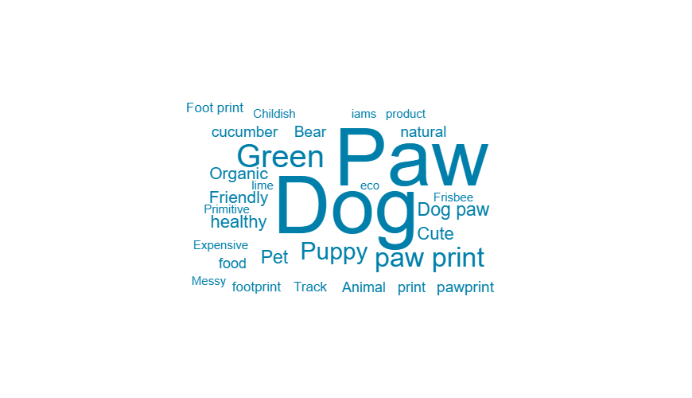
Attribute: First reaction
What's the first word that comes to mind when you look at this logo?
Logo 2
Top 10 words
Word Cloud
Dog |  | 22.31% | 85
Paw |  | 22.31% | 85
Green |  | 6.82% | 26
paw print |  | 5.25% | 20
Puppy |  | 4.20% | 16
Pet |  | 2.36% | 9
Dog paw |  | 2.36% | 9
healthy |  | 2.10% | 8
Cute |  | 2.10% | 8
Friendly |  | 1.84% | 7
N = 782
Location: United States (USA); Regions: All regions; Gender Balancing: Custom; Age: 18-99; Age Balancing: None; Income: $0-$200k+;

Slide 11
Attribute Scorecard: Overall appeal
Overall, how much do you like this ad?
Confidence level
95%
A Logo 1
B Logo 2
FoodBenchmark
Top 2 Box score | 63% B | 47% | 47%
Bottom 2 Box score | 8% | 15% A | 10%
Like it a lot | 30% B | 15% | 20%
Somewhat like it | 34% | 31% | 27%
Neutral | 29% | 38% A | 43%
Somewhat dislike it | 6% | 10% A | 6%
Dislike it a lot | 2% | 5% A | 4%
N = 782
Location: United States (USA); Regions: All regions; Gender Balancing: Custom; Age: 18-99; Age Balancing: None; Income: $0-$200k+;

Slide 12
Attribute Scorecard: Unique
How unique is this logo?
Confidence level
95%
A Logo 1
B Logo 2
FoodBenchmark
Top 2 Box score | 34% B | 19% | 31%
Bottom 2 Box score | 21% | 38% A | 28%
Extremely unique | 9% B | 4% | 11%
Very unique | 26% B | 16% | 20%
Somewhat unique | 45% | 43% | 41%
Not so unique | 17% | 30% A | 23%
Not at all unique | 4% | 8% A | 5%
N = 782
Location: United States (USA); Regions: All regions; Gender Balancing: Custom; Age: 18-99; Age Balancing: None; Income: $0-$200k+;

Slide 13
Attribute Scorecard: Visually appealing
How visually appealing is this ad?
Confidence level
95%
A Logo 1
B Logo 2
FoodBenchmark
Top 2 Box score | 49% B | 32% | 32%
Bottom 2 Box score | 17% | 29% A | 23%
Extremely appealing | 15% B | 7% | 10%
Very appealing | 34% B | 25% | 22%
Somewhat appealing | 35% | 39% | 44%
Not so appealing | 13% | 22% A | 18%
Not at all appealing | 4% | 7% | 5%
N = 782
Location: United States (USA); Regions: All regions; Gender Balancing: Custom; Age: 18-99; Age Balancing: None; Income: $0-$200k+;

Slide 14
Attribute Scorecard: Stands out
How well do you think this logo would stand out against those already in the market?
Confidence level
95%
A Logo 1
B Logo 2
FoodBenchmark
Top 2 Box score | 41% B | 29% | 39%
Bottom 2 Box score | 24% | 32% A | 23%
Extremely well | 12% | 8% | 12%
Very well | 29% B | 22% | 27%
Somewhat well | 35% | 39% | 38%
Not so well | 20% | 24% | 19%
Not at all well | 4% | 7% A | 4%
N = 782
Location: United States (USA); Regions: All regions; Gender Balancing: Custom; Age: 18-99; Age Balancing: None; Income: $0-$200k+;

Slide 15
Of the following, which logo do you like the best?
Comparison question
N = 782
Location: United States (USA); Regions: All regions; Gender Balancing: Custom; Age: 18-99; Age Balancing: None; Income: $0-$200k+;

Slide 16
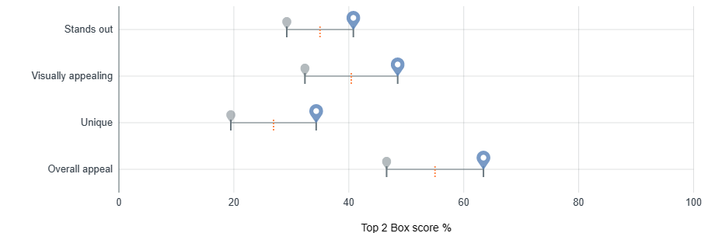
Attribute scores
Here's how the concept among the different attributes respondents rated.
Logo 1
Logo 1 score
Other concept score
Minimum
Maximum
Average
N = 782
Location: United States (USA); Regions: All regions; Gender Balancing: Custom; Age: 18-99; Age Balancing: None; Income: $0-$200k+;

Slide 17
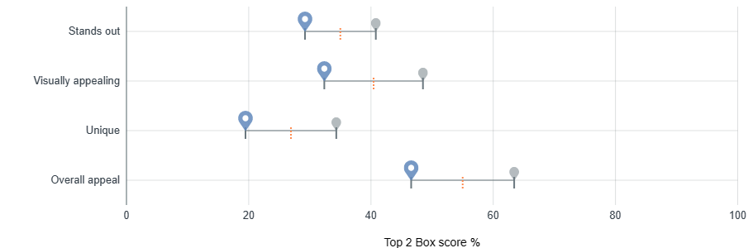
Attribute scores
Here's how the concept among the different attributes respondents rated.
Logo 2
Logo 2 score
Other concept score
Minimum
Maximum
Average
N = 782
Location: United States (USA); Regions: All regions; Gender Balancing: Custom; Age: 18-99; Age Balancing: None; Income: $0-$200k+;

